Slide 1

Welcome to our class
Phu Dong Primary School

Slide 2


Unit 1: Nice to see you again
Lesson 2

Slide 3
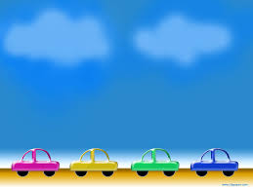
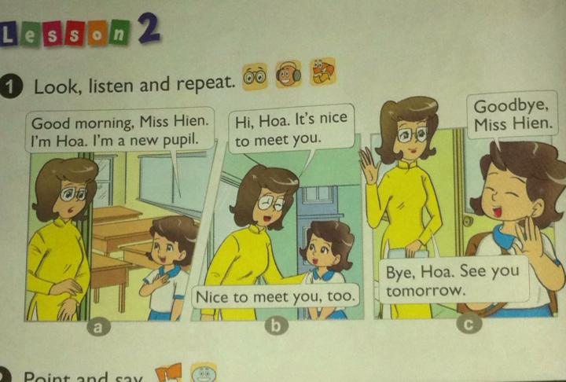
Unit 1: Nice to see you again
Lesson 2

Slide 4

Vocabulary
New pupil
Goodbye = Bye
Tomorrow
See you tomorrow
See you later

Slide 5


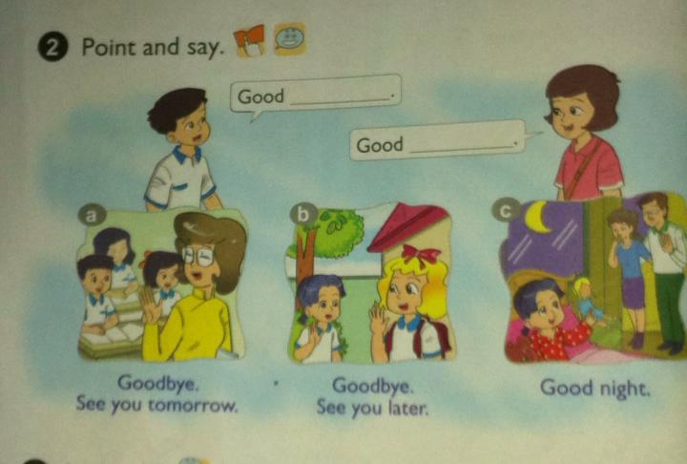
Unit 1: Nice to see you again
Lesson 2: 1-2-3-4-5-6

Slide 6

Saying and responding to goodbye
E.g.:
Teacher: Goodbye, class.
Class: Goodbye. See you later.
Saying
Responding
A: Goodbye, name.
A: Good night, name₁
B: Goodbye. See you tomorrow/ later.
B: Good night, name₂

Slide 7
Unit 1: Nice to see you again
Lesson 2: 1-2-3-4-5-6

Slide 8
2. Point and say.
a) Class: Goodbye, Miss Hien.
Miss Hien: Goodbye. See you tomorrow.
b) Mai: Goodbye, Linda.
Linda: Goodbye. See you later.
c) A: Good night, Mum and Daddy.
B: Good night, Mai.

Slide 9
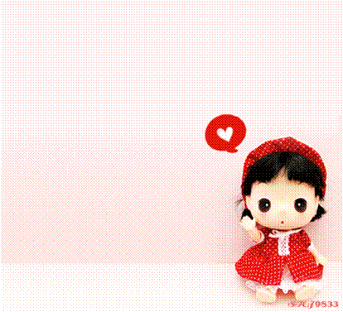
3. Let’s talk
Good ………………… . Nice to meet you.
Good ………… . See you tomorrow.
morning
bye

Slide 10
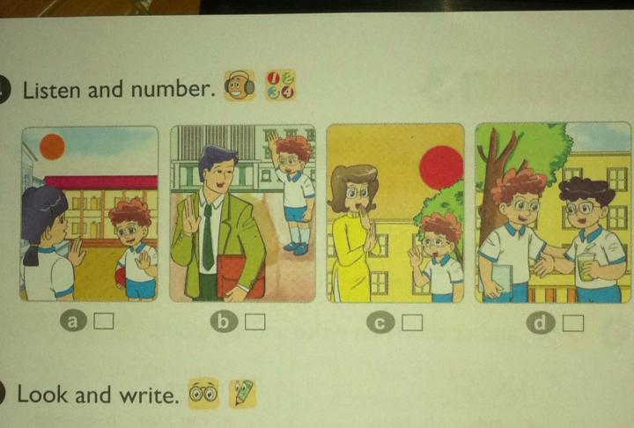
Unit 1: Nice to see you again
Lesson 2: 1-2-3-4-5-6

Slide 11

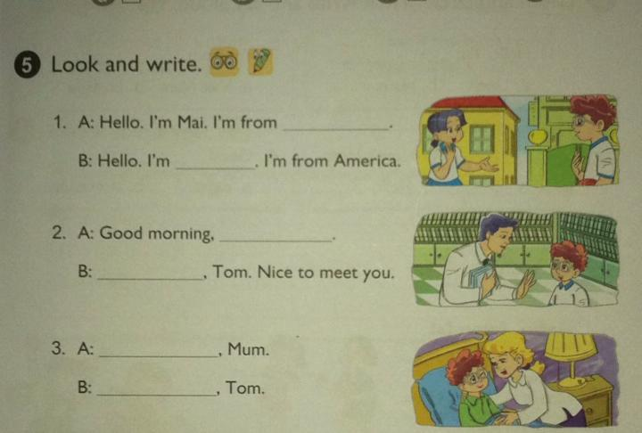
Unit 1: Nice to see you again
Lesson 2: 1-2-3-4-5-6

Slide 12

Homework
Learn new words by heart
Practice the dialogue at home
Do exercise in workbook
Prepare for next lesson

Slide 13
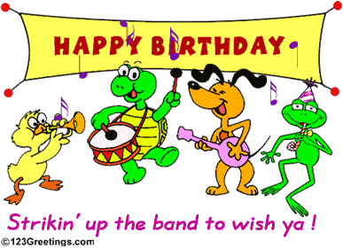
The end
Goodbye
See you later!
Notes:
13

